Slide 1
Replication Crisis

Slide 2
The “Stapel Debacle” – raised questions about the standards of scientific research (especially in social psychology)
Reputations of top journals took a hit
Daryl Bem published study about extra-sensory perceptions. (Bem, 2011)
E.g. extraverts seemed to be able to foresee the location of images before a computer program determined the location
Did not use scientific methods properly
Results actually provide no credible empirical evidence for ESP claims (Francis, 2012; Schimmack, 2012; Schimmack, 2018)

Slide 3
Controversy in Science
“Why most published research findings are false” (Ioannidis, 2005)
Reaction
Disbelief
Self-serving bias
Problem in psychology?

Slide 4
Controversy in Psychology
“Estimating the reproducibility of psychological science” (Open Science Collaboration, 2015)
Effort in ‘08 to replicate findings of 100 studies in top-tier psychology journals
270 contributing researchers
Results
Of 97 original significant findings, only 35 successfully replicated.
Of the studies that did replicate, effect sizes were half as big in replications as in original studies
‘Replication Crisis in Psychology
Since, psychologists have put practices and results of experiments under the microscope.

Slide 5
Possible Causes of Replication Crisis
Ioannidis’ (2005) suggestions:
Small studies with small effect sizes
Many comparisons, little preselection
Flexibility in designs, definitions, outcomes, analyses
Prejudices and financial interests
Published research is NOT a representative sample of all research
Publication bias: journals mostly publish research that produces significant differences
File-drawer Problem
“Null” research could be interesting to others (but sits unpublished in file drawers)
But there are many more “null” findings than significant findings.

Slide 6
Possible Causes of Replication Crisis
Small studies, small effect sizes
Small studies more likely to produce Type I errors
Probability of heads on 10 coin flips or 100 coin flips
Which one is more likely to produce 70% heads?
More likely to deviate from mean with small sample sizes, in coin flips as well as behavioral science
Many comparisons, little preselection
There is always a chance of Type I error
The more indiscriminate comparisons, the more Type I errors
Comparing lots of variables against lots of other variables: a fishing expedition
Specify in advance which comparisons to make, guided by theory
Correct for multiple comparisons (p-value adjustment, Bonferroni adjustment)

Slide 7
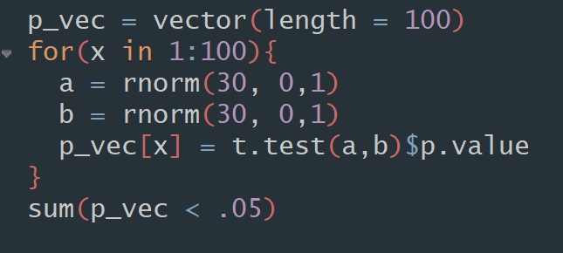

Testing Type I Error Rate

Slide 8
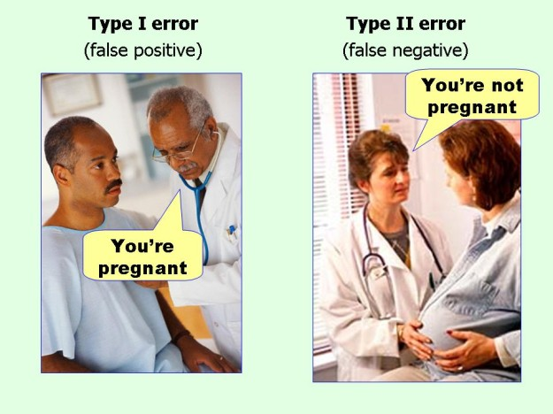
Type I vs II error
[Credit to my wife for showing me this picture]
Type I (the more serious error)
The probability of finding an effect when it actually does not exist
Type II
The probability of not finding an effect when it actually does exist in a population.

Slide 9
Possible Causes of Replication Crisis
HARKing
Hypothesizing After Results are Known
Create hypothesis first, collect data, then evaluate hypothesis
Do NOT change hypothesis after seeing outcome of the study so that new hypothesis supports results.
Flexibility in design and definitions of a study
Being ‘slippery’
Example: Measuring effect of stress on health
What is ‘health’? Anything that stress affects?
Be specific: health means not dead (hard to be slippery on measurements).

Slide 10
Possible Causes of Replication Crisis
Financial interests
Many types of science requires funding
Funding organizations exert pressure on scientists to produce certain results. If desired results aren’t produced, funding goes away
Other conflicts of interest
“Publish or Perish” atmosphere in academia
Researchers have to publish something or they risk losing their jobs (and journals don’t like to publish null results)

Slide 11
Is science self-correcting? (Pashler & Harris, 2012)
Just wait long enough, and erroneous findings will actually be debunked in an explicit fashion.
The median time between the original target article and a ‘replication’ attempt was 4 years. Most replications target very recent research – no sign of long-lag corrections taking place
If not specifically corrected, the field will ‘collectively’ move on to focus on other more valid phenomena.
The new fad diet? The new fad research!
Trends in science move on for both successful, and unsuccessful areas.

Slide 12
Does this mean research is just a waste of time?
Internet trolls:
Most psychology doesn’t replicate
Don’t trust psychology
Response
We’ve discovered the problem. We’re working on it
Changes in:
The way we conduct research
The way we submit research for publication
The way we publish.

